Slide 1
Enhanced ER-diagram

Slide 2
Database Modeling and Implementation Process
Ideas
ER Design
Relational Schema
Relational DBMS
Implementation

Slide 3
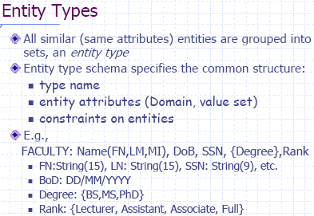

Slide 4
Example: A library database contains a listing of authors that have written books on various subjects (one author per book). It also contains information about libraries that carry books on various subjects.

Slide 5
RELATIONSHIPS (Cont…)
Example: A library database contains a listing of authors that have written books on various subjects (one author per book). It also contains information about libraries that carry books on various subjects.
  Entity sets: authors, subjects, books, libraries

Slide 6
RELATIONSHIPS (Cont…)
Example: A library database contains a listing of authors that have written books on various subjects (one author per book). It also contains information about libraries that carry books on various subjects.
  Entity sets: authors, subjects, books, libraries
  Relationship sets: wrote, carry, indexed

Slide 7
RELATIONSHIPS (Cont…)
Subject
matter
title
isbn
SS#
authors
wrote
books
index
subject
name
carry
address
libraries

Slide 8
RELATIONSHIPS (Cont…)
Subject
matter
title
isbn
SS#
authors
wrote
books
index
subject
name
quantity
carry
address
libraries

Slide 9
BINARY RELATIONSHIP
A binary relationship between entity set A and B might be:
1:1 Women marrying Men (function)
N:1 Children having mothers (function)
1:N Mothers having children (inverse function)
M:N Students enrolled in a class
women
marry
men
A
B
n
1
A
B
children
having
mothers
1
having
n
mothers
children
A
B
students
enrolled
classes
A
B

Slide 10
KEY
Entities and relationships are distinguishable using various keys
A key is a combination of one or more attributes, e.g., social-security number, combination of name and social-security number.
A superkey is a key defined either for an entity set or relationship set that uniquely identifies an entity, e.g., social-security number, phone number, combination of name and social-security number.
A candidate key is a minimal superkey that uniquely identifies either an entity or a relationship, e.g., social-security number, phone number.
A primary key is a candidate key that is chosen by the database designer to identify the entities of an entity set.

Slide 11
A foreign key is a set of one or more attributes of a strong entity set that are employed to construct the discriminator of a weak entity set. The primary key of a weak entity set is formed by the primary key of the strong entity set on which it is existence-dependent.
Relationship sets also have primary keys. Assume R is a relationship set involving entity sets E₁, E₂, ..., E_{n}. Let primary-key(E_{i}) denote the primary key for entity set E_{i}. Assume primary-key(E_{i}) is unique for 1 ≤ i ≤ n. If R has no attributes then its superkey is:
primary-key(E₁) ∪ primary-key(E₂) ∪ ... ∪ primary-key(E_{n})
This is a primary key if the mapping constraint is many-to-many.
If the mapping constraint is many to one from E₁ to E₂ then the primary key of R is primary key of E₁.
SS#
wrote
title
authors
books
name
edition
E₁
R
E₂

Slide 12
EXAMPLE
Employees of a large company, e.g., IBM, where an employee reports to a manager. The manager is also an employee who reports to another manager. This chain of command continues to the very top where the CEO is the only employee who is not reporting to a manager. Draw the ER diagram for this example.

Slide 13
SS#
Works
for
Emp
name
address
Primary keys:
Emp: SS#
Works-for: (empSS#, mgrSS#)
SS#
Works
for
Emp
name
Primary keys:
Emp: SS#
Works-for: (empSS#)
address

Slide 14
A relationship may involve n entities, N-ary relationship
It is always possible to replace a non-binary relationship set by a number of distinct binary relationship sets
People
fans
Football Teams
on
Date

Slide 15
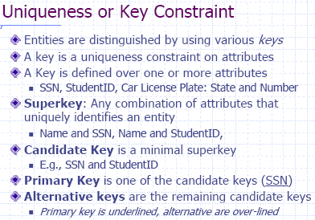

Slide 16
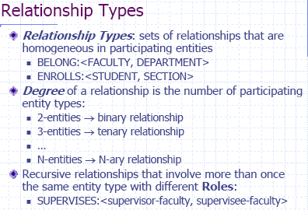

Slide 17
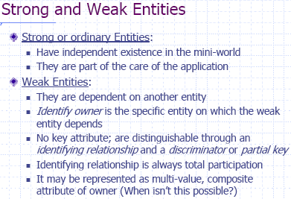

Slide 18
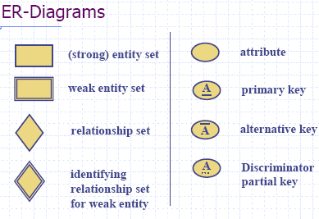
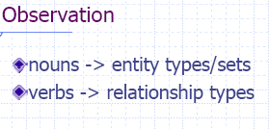

Slide 19
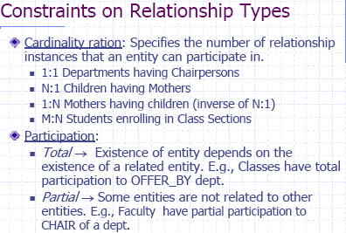

Slide 20
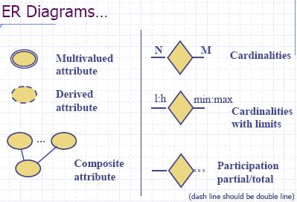

Slide 21
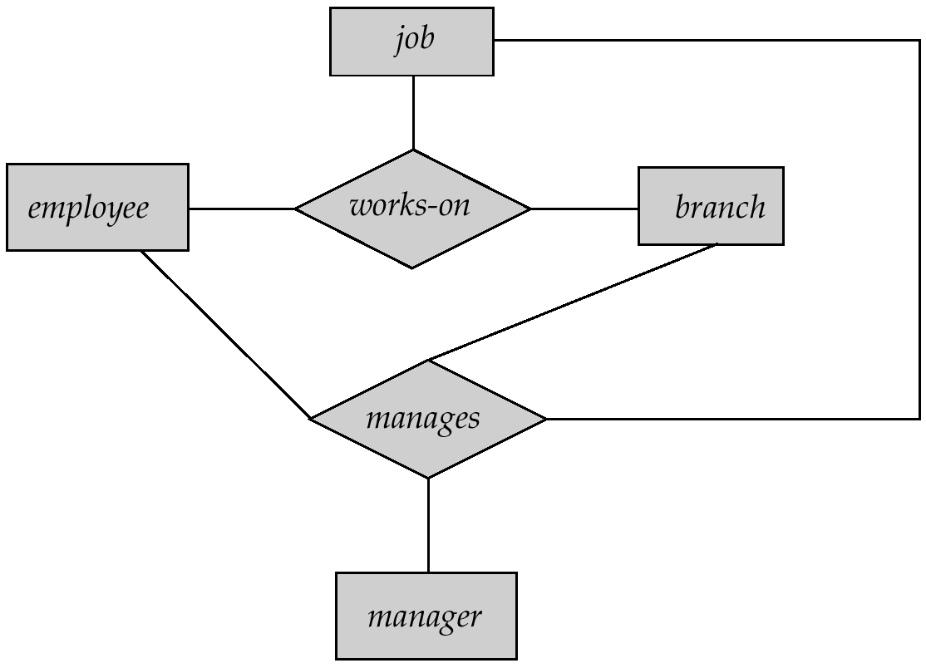
Aggregation
Consider the ternary relationship works-on, which we saw earlier
Suppose we want to record managers for tasks performed by an
employee at a branch

Slide 22

E-R Diagram With Aggregation

Slide 23
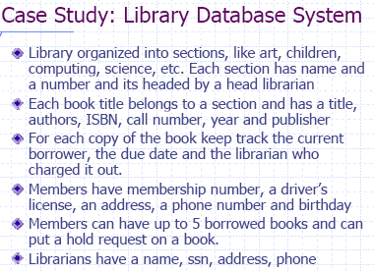

Slide 24
Example: A library database contains a listing of authors that have written books on various subjects (one author per book). It also contains information about libraries that carry books on various subjects.
  Entity sets: authors, subjects, books, libraries
  Relationship sets: wrote, carry, indexed
  E-R diagram:

Slide 25
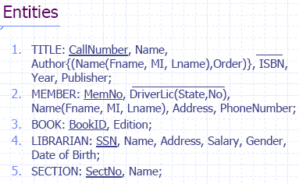
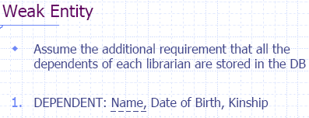

Slide 26
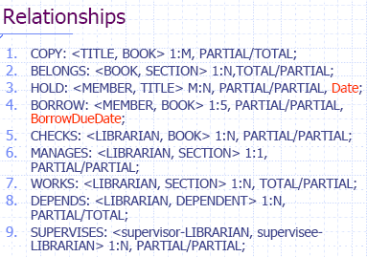

Slide 27
Enhanced Entity-Relationship Model
Since 1980s there has been an increase in emergence of new database applications with more demanding requirements.
Basic concepts of ER modeling are not sufficient to represent requirements of newer, more complex applications.
Response is development of additional ‘semantic’ modeling concepts.

Slide 28
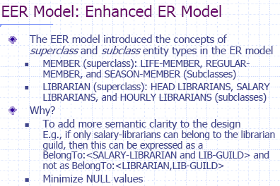

Slide 29
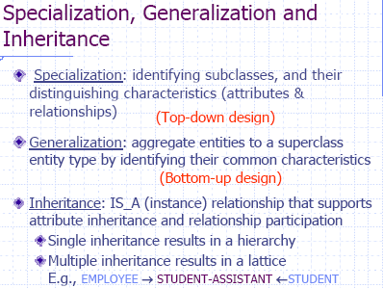

Slide 30
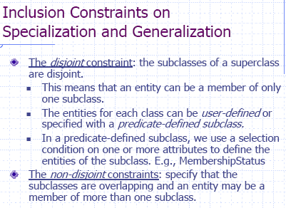

Slide 31
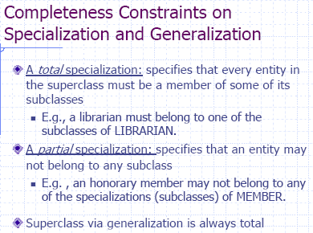

Slide 32
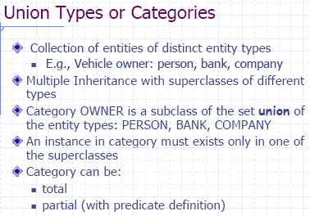

Slide 33
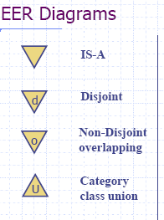


Slide 34
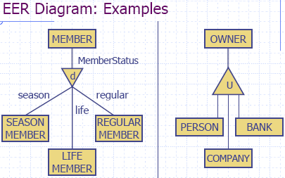

Slide 35
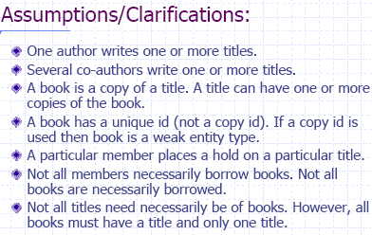

Slide 36
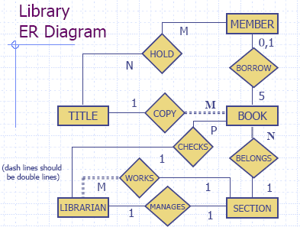

Slide 37
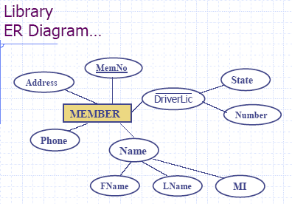

Slide 38
Enhanced-ER (EER) Model Concepts
Includes all modeling concepts of basic ER
Additional concepts: subclasses/superclasses, specialization/generalization, categories, attribute inheritance
The resulting model is called the enhanced-ER or Extended ER (E2R or EER) model
It is used to model applications more completely and accurately if needed
It includes some object-oriented concepts, such as inheritance

Slide 39
Subclasses and Superclasses (1)
An entity type may have additional meaningful subgroupings of its entities
Example: EMPLOYEE may be further grouped into SECRETARY, ENGINEER, MANAGER, TECHNICIAN, SALARIED_EMPLOYEE, HOURLY_EMPLOYEE,…
  Each of these groupings is a subset of EMPLOYEE entities
  Each is called a subclass of EMPLOYEE
  EMPLOYEE is the superclass for each of these subclasses
These are called superclass/subclass relationships.
Example: EMPLOYEE/SECRETARY, EMPLOYEE/TECHNICIAN

Slide 40


Slide 41
Subclasses and Superclasses (2)
These are also called IS-A relationships (SECRETARY IS-A EMPLOYEE, TECHNICIAN IS-A EMPLOYEE, …).
Note: An entity that is member of a subclass represents the same real-world entity as some member of the superclass
  The Subclass member is the same entity in a distinct specific role
  An entity cannot exist in the database merely by being a member of a subclass; it must also be a member of the superclass
  A member of the superclass can be optionally included as a member of any number of its subclasses
Example: A salaried employee who is also an engineer belongs to the two subclasses ENGINEER and SALARIED_EMPLOYEE
  It is not necessary that every entity in a superclass be a member of some subclass

Slide 42
Attribute Inheritance in Superclass / Subclass Relationships
An entity that is member of a subclass inherits all attributes of the entity as a member of the superclass
It also inherits all relationships

Slide 43
Specialization
Is the process of defining a set of subclasses of a superclass
The set of subclasses is based upon some distinguishing characteristics of the entities in the superclass
Example: {SECRETARY, ENGINEER, TECHNICIAN} is a specialization of EMPLOYEE based upon job type.
  May have several specializations of the same superclass
Example: Another specialization of EMPLOYEE based in method of pay is {SALARIED_EMPLOYEE, HOURLY_EMPLOYEE}.
  Superclass/subclass relationships and specialization can be diagrammatically represented in EER diagrams
  Attributes of a subclass are called specific attributes. For example, TypingSpeed of SECRETARY
  The subclass can participate in specific relationship types. For example, BELONGS_TO of HOURLY_EMPLOYEE

Slide 44
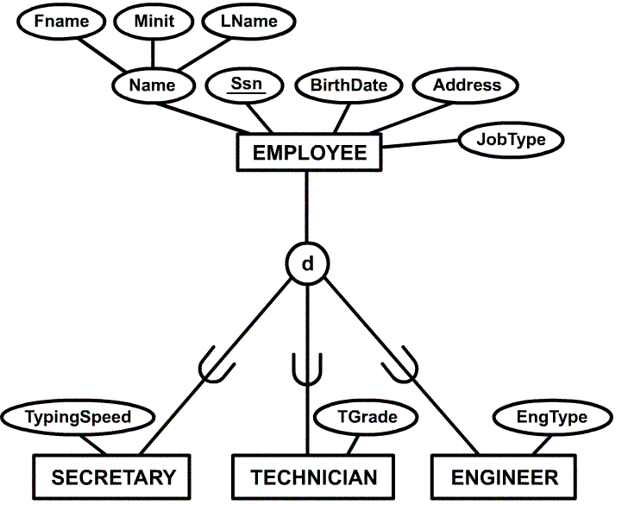
Example of a Specialization

Slide 45
Generalization
The reverse of the specialization process
Several classes with common features are generalized into a superclass; original classes become its subclasses
Example: CAR, TRUCK generalized into VEHICLE; both CAR, TRUCK become subclasses of the superclass VEHICLE.
  We can view {CAR, TRUCK} as a specialization of VEHICLE
  Alternatively, we can view VEHICLE as a generalization of CAR and TRUCK

Slide 46
Generalization and Specialization
  Arrow pointing to the generalized superclass represents a generalization
  Arrows pointing to the specialized subclasses represent a specialization
  We do not use this notation because it is often subjective as to which process is more appropriate for a particular situation
  We advocate not drawing any arrows in these situations
  A superclass or subclass represents a set of entities
  Shown in rectangles in EER diagrams (as are entity types)
  Sometimes, all entity sets are simply called classes, whether they are entity types, superclasses, or subclasses

Slide 47
Generalization
A bottom-up design process – combine a number of entity sets that share the same features into a higher-level entity set.
Specialization and generalization are simple inversions of each other; they are represented in an E-R diagram in the same way.
The terms specialization and generalization are used interchangeably.

Slide 48
Constraints on Specialization and Generalization (1)
If we can determine exactly those entities that will become members of each subclass by a condition, the subclasses are called predicate-defined (or condition-defined) subclasses
  Condition is a constraint that determines subclass members
  Display a predicate-defined subclass by writing the predicate condition next to the line attaching the subclass to its superclass
If all subclasses in a specialization have membership condition on same attribute of the superclass, specialization is called an attribute defined-specialization
  Attribute is called the defining attribute of the specialization
  Example: JobType is the defining attribute of the specialization {SECRETARY, TECHNICIAN, ENGINEER} of EMPLOYEE
If no condition determines membership, the subclass is called user-defined
  Membership in a subclass is determined by the database users by applying an operation to add an entity to the subclass
  Membership in the subclass is specified individually for each entity in the superclass by the user

Slide 49
Constraints on Specialization and Generalization (2)
Two other conditions apply to a specialization/generalization:
Disjointness Constraint:
  Specifies that the subclasses of the specialization must be disjointed (an entity can be a member of at most one of the subclasses of the specialization)
  Specified by d in EER diagram
  If not disjointed, overlap; that is the same entity may be a member of more than one subclass of the specialization
  Specified by o in EER diagram
Completeness Constraint:
  Total specifies that every entity in the superclass must be a member of some subclass in the specialization/ generalization
  Shown in EER diagrams by a double line
  Partial allows an entity not to belong to any of the subclasses
  Shown in EER diagrams by a single line

Slide 50
Constraints on Specialization and Generalization (3)
Hence, we have four types of specialization/generalization:
  Disjoint, total
  Disjoint, partial
  Overlapping, total
  Overlapping, partial
Note: Generalization usually is total because the superclass is derived from the subclasses.

Slide 51
Example of disjoint partial Specialization

Slide 52
Specialization / Generalization Hierarchies, Lattices and Shared Subclasses
A subclass may itself have further subclasses specified on it
Forms a hierarchy or a lattice
Hierarchy has a constraint that every subclass has only one superclass (called single inheritance)
In a lattice, a subclass can be subclass of more than one superclass (called multiple inheritance)

Slide 53
In a lattice or hierarchy, a subclass inherits attributes not only of its direct superclass, but also of all its predecessor superclasses
A subclass with more than one superclass is called a shared subclass
Can have specialization hierarchies or lattices, or generalization hierarchies or lattices
In specialization, start with an entity type and then define subclasses of the entity type by successive specialization (top down conceptual refinement process)
In generalization, start with many entity types and generalize those that have common properties (bottom up conceptual synthesis process)
In practice, the combination of two processes is employed

Slide 54
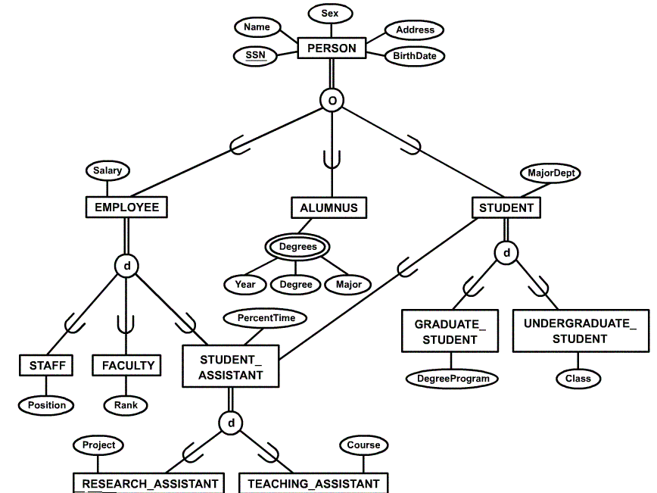
Specialization / Generalization Lattice Example (UNIVERSITY)

Slide 55
Categories (UNION TYPES)
All of the superclass/subclass relationships we have seen thus far have a single superclass
A shared subclass is subclass in more than one distinct superclass/subclass relationships, where each relationships has a single superclass (multiple inheritance)
In some cases, need to model a single superclass/subclass relationship with more than one superclass
Superclasses represent different entity types
Such a subclass is called a category or UNION TYPE

Slide 56
Example: Database for vehicle registration, vehicle owner can be a person, a bank (holding a lien on a vehicle) or a company.
  Category (subclass) OWNER is a subset of the union of the three superclasses COMPANY, BANK, and PERSON
  A category member must exist in at least one of its superclasses
Note: The difference from shared subclass, which is subset of the intersection of its superclasses (shared subclass member must exist in all of its superclasses).

Slide 57
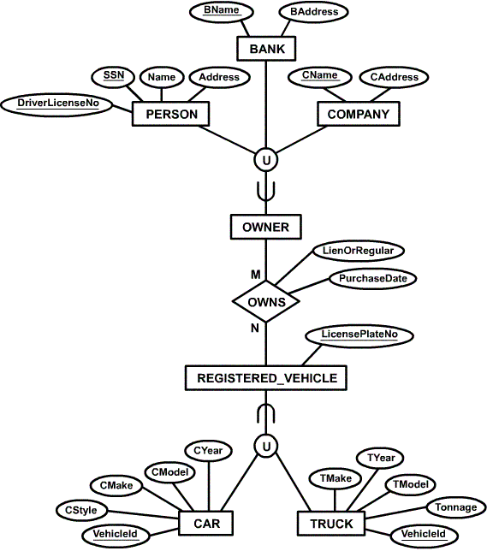
Example of categories
(UNION TYPES)

Slide 58
Specialization
This is the process of maximising the differences between members of an entity by identifying their distinguishing characteristics.
Staff(staff_no,name,address,dob)
Manager(bonus)
Secretary(wp_skills)
Sales_personnel(sales_area, car_allowance)

Slide 59
GENERALIZATION AND SPECIALIZATION
Generalization is the result of computing the union of two or more entity sets to produce a higher-level entity set. It represents the containment relationship that exists between the higher-level entity set and one or more lower-level entity sets.
Specialization constructs the lower level entity sets that are a subset of a higher level entity set.

Slide 60
GENERALIZATION AND SPECIALIZATION
student
sid
name
Generalization
is A
Specialization
Undergrad
graduate

Slide 61
GENERALIZATION AND SPECIALIZATION
Undergrad and graduate are termed subclasses of the superclass student.
This is a superclass/subclass or simply class/subclass relationship.
A member of a subclass MUST be a member of the superclass.
An alternative notation is the Union symbol
The circle with d specifies that the specializations are disjoint. A member of Undergrad entity set may NOT be a member of the graduate entity set.

Slide 62
GENERALIZATION AND SPECIALIZATION
student
sid
name
Generalization
d
Specialization
U
U
Undergrad
graduate

Slide 63
A design may require all members of an entity-set to be specialized. For example, an employee MUST be a member of either a Salaried or Part-time. Use double lines to dictate this constraint

Slide 64
GENERALIZATION AND SPECIALIZATION
Emp
sid
name
Generalization
d
Specialization
U
U
Salaried
Part-time

Slide 65
GENERALIZATION AND SPECIALIZATION
One may allow the specialized entity sets to overlap. For example, an entity might be both a Salaried and Part-time. “o” stands for Overlap when specializing.
Emp
sid
name
Generalization
o
Specialization
U
U
Salaried
Part-time

Slide 66
Generalisation
Generalisation is the process of minimising the differences between entities byidentifying common features.
This is the identification of a generalised superclass from the original subclasses. This is the process of identifying the common attributes and relationships.

Slide 67
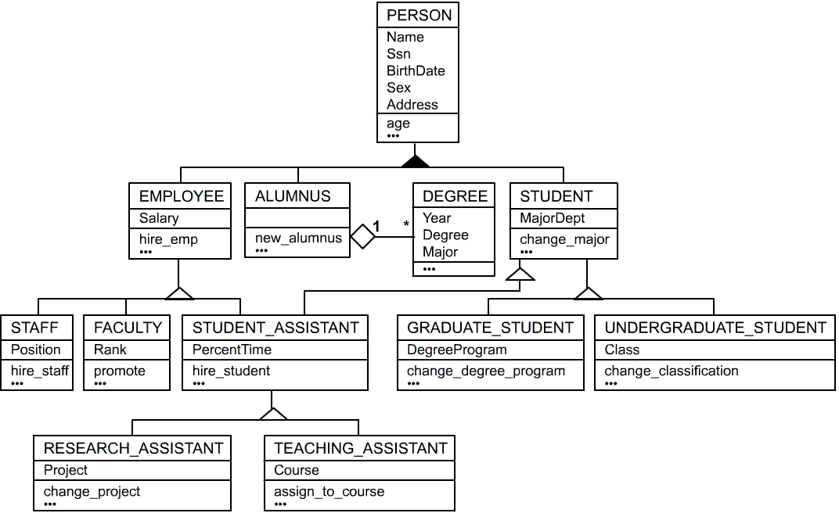
UML Example for Displaying Specialization / Generalization

Slide 68

Alternative Diagrammatic Notations
Symbols for entity type / class, attribute and relationship

Slide 69
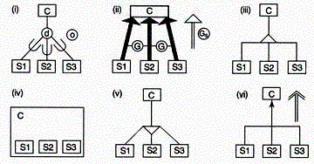
Notations for displaying specialization / generalization

Slide 70
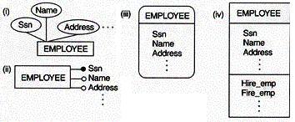
Displaying attributes

Slide 71
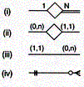
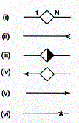
Various (min, max) notations
Displaying cardinality ratios

Slide 72
